Slide 1

The T-1 Program is a strategic accelerator for AT's asset resilience, delivering a 1.7-year payback and strong long-term NPV.
AI Digital Twin-Driven T-1 Predictive Maintenance Program
Consultant: Yunmiao Zhang | Role: Business Integrator
Financial Snapshot:
Investment Request: $12 M (Over 3 Years)
Payback Period (PBP): 1.7 Years
10-Year NPV (Base Case): $75 M
Yunmiao Zhang
-
Auckland Transport
-
1

Slide 2

This report follows a structured, hypothesis-driven approach, focusing on quantifiable value and executable steps.
Table of Contents
The Business Imperative: Problem & Opportunity
The T-1 Solution: Phased Implementation Roadmap
Financial Viability: Payback and NPV Analysis
Execution & Governance: The Role of the Business Integrator
Risk Mitigation & Call to Action

Slide 3

The current reactive maintenance model is unsustainable, with an 15% failure rate causing an estimated $8M annual loss.
Operational Risk: Current processes are reactive, lacking data-driven foresight, leading to key asset unplanned failure rates of 15%.
Financial Impact: Unforeseen critical repairs drive high non-discretionary costs, estimated at $8M annually in direct and indirect expenses.
Public Trust & Resilience: High failure rates compromise service reliability, eroding public trust and increasing regulatory scrutiny (L-1 principles).
Strategic Opportunity: T-1 will reduce the failure rate to the international benchmark (4%) within three years, positioning AT as a technology leader.
Figure A: Operational Efficiency Benchmark:
(Describe the chart showing the gap between AT's 15% status quo vs. the 5.0% international benchmark).
Year | AT Current State (15%) | International Benchmark (TfL / LTA) | T-1 Target (Forecast)
0 (Pre-Launch) | 15.0% | 5.0% | 15.0%
1 (Foundation Build) | 14.5% | 5.0% | 12.0%
2 (Model Validation) | 10.0% | 5.0% | 7.0%
3 (PBP Achieved) | 7.0% | 5.0% | 4.0%
4 (Scale-Up Efficiency) | 5.0% | 5.0% | 3.5%
5 (Steady-State Operations) | 4.0% | 5.0% | 3.0%
2

Slide 4

The solution is deployed in three agile phases, prioritizing data governance to ensure the accuracy of the AI model's foundational data.
Phase 1: Foundation & Data Governance (0-12M):
Focus: MECE-structured data cleansing and standardization of historical maintenance records.
Output: L-1 data transparency protocol established; 50% sensor pilot deployment complete.
Phase 2: Model Validation & Process Re-engineering (13-24M):
Focus: Achieve AI model accuracy > 85%; conduct process re-engineering for Alert-to-Action SOPs.
Output: First wave of critical asset failures reduced; training modules deployed.
Phase 3: Scale & Value Maximization (25-36M):
Focus: Full system integration and organization-wide rollout (80% of core assets).
Output: PBP achieved (1.7 years); full realization of operational efficiency gains.
3

Slide 5
The T-1 program demonstrates strong financial attractiveness, with the total investment recovered in just 1.7 years.
Budget Allocation ($12M)
Technology & Data Investment = 83% (Core Focus)
Figure B: Cumulative Net Cash Flow (CNCF) Curve:
(Describe the line chart where the CNCF curve intersects the X-axis at 1.7 years).
The rapid PBP minimizes exposure to long-term risk and immediately frees up cash flow for further innovation.
4

Slide 6
The project’s substantial 10-year NPV demonstrates significant financial resilience, maintaining positive value across all reasonable scenarios.
Long-Term Value: The project delivers a $75 M Net Present Value (NPV) over 10 years (at a 6% discount rate).
Financial Resilience: The Base Case assumes a 75% reduction in unplanned failures, driving the $75 M NPV.
Figure C: NPV Sensitivity Analysis (Three Scenarios):
(Describe the column/bar chart showing the comparison between the three scenarios).
Worst Case ($58 M NPV): Even if savings fall to the minimum ($6 M NCF),
the NPV remains a highly favorable $58 M, mitigating downside risk.
Upside Potential: Under the Optimistic Scenario (NCF $10 M),
the NPV surges to $114 M.
5

Slide 7
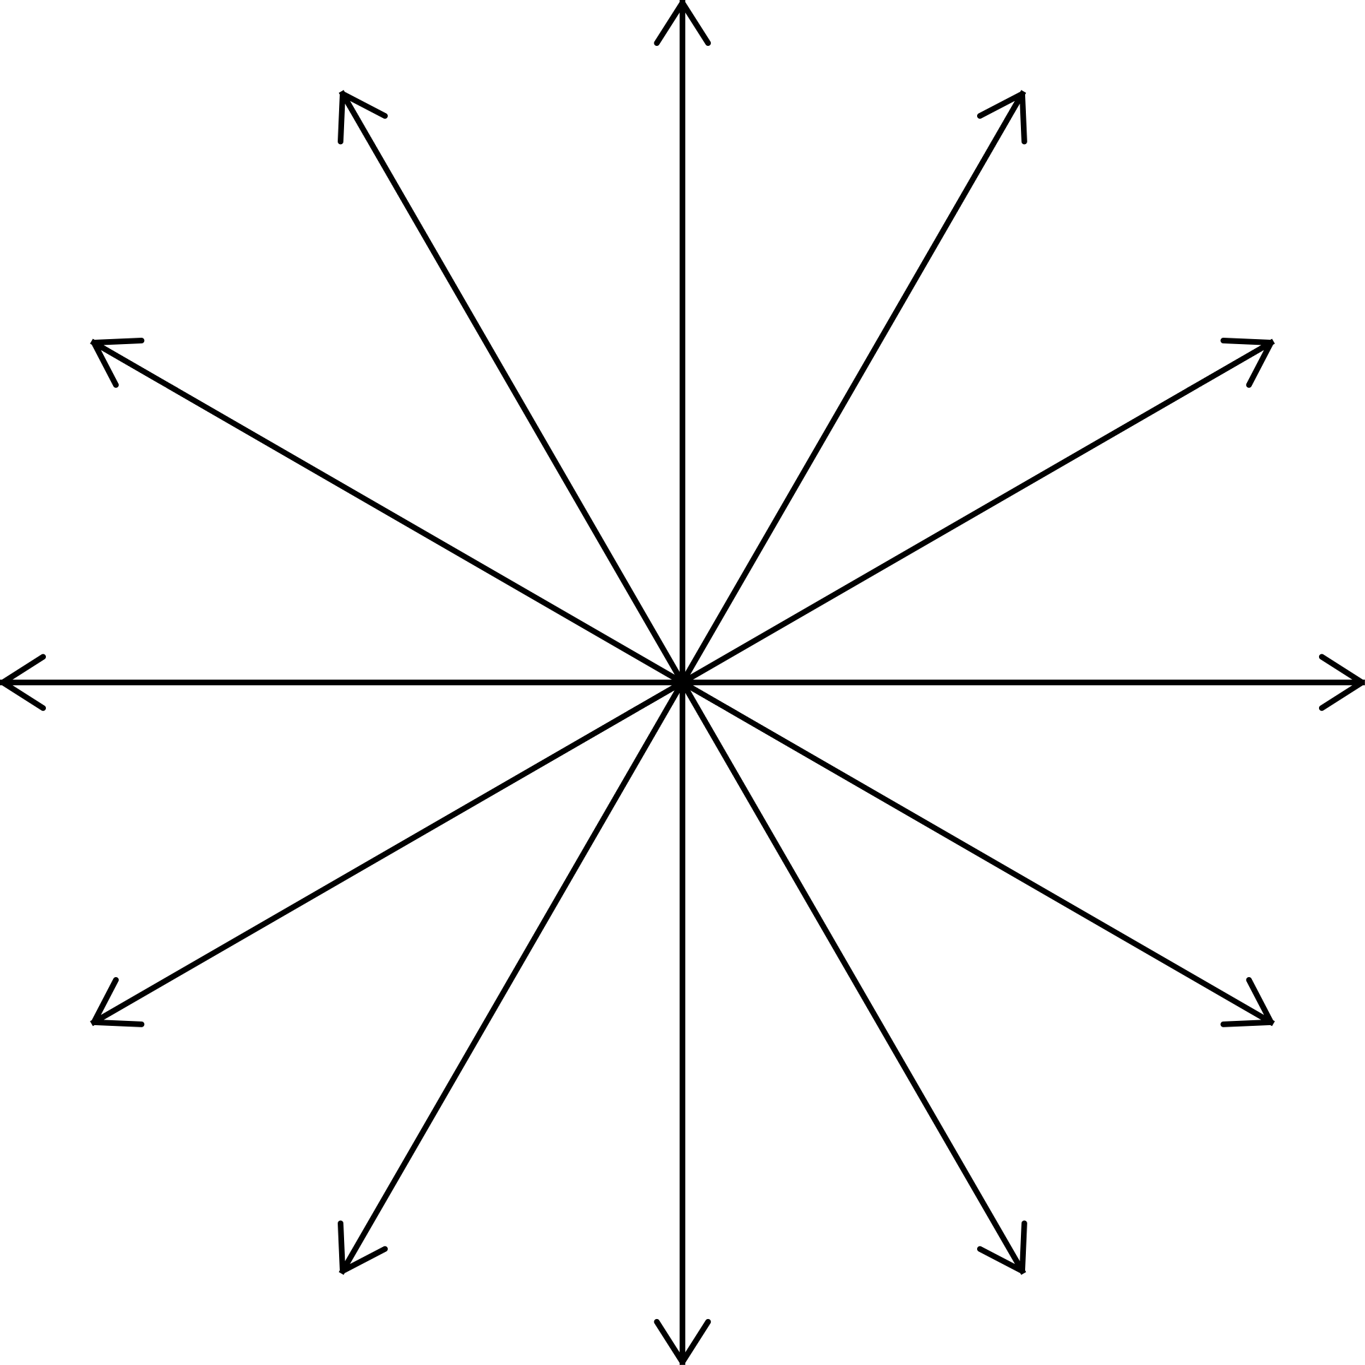
Project success is secured by robust cross-functional governance and the leadership of a Business Integrator who translates AI output into actionable operations.
COO - Executive Sponsor
┌───────────────────────────────────────┐
│ Business Integrator –Yunmiao Zhang │
│ “Bridge between Technology & Operations” │
└───────────────────────────────────────┘
🔁 Operating Model Redesign
Leading the SOP re-engineering for maintenance scheduling and AI alert response.
📊 Financial Tracking:
Establishing systems to monitor PBP achievement and quantify savings for executive reporting.
🧭 Data Governance & Compliance:
Ensuring L-1 data transparency is implemented and audited, turning AI outputs into auditable field actions.
Operations & Maintenance
IT / Data Science
Finance & Legal
Execution
Analytics
Compliance
6

Slide 8
All core risks are fully identified and mitigated, creating a secure investment pathway for the Board.
Key Risks & Mitigation:
1. Data Quality & Governance (High Risk):
Mitigation: Implement the L-1 data transparency protocol from the pilot stage to enforce early standards.
2. Organizational Change Resistance:
Mitigation: Integrate maintenance teams into the model design and training from Phase 1 to build adoption and capability.
3. IT Integration (Medium Risk):
Mitigation: Utilize an API-first architecture for a loosely coupled integration with legacy systems (e.g., SAP PM).
Call to Action (The Ask):
CAPEX Approval: Immediately approve the $12 M T-1 Program startup budget.
Team Authorization: Formally authorize the cross-functional team and appoint the Business Integrator.
Strategic Mandate: Elevate T-1 Data Governance to a Top Strategic Priority for AT for the next 12 months.
7

Slide 9
AI Digital Twin-Driven T-1 Predictive Maintenance Program
Thank you !
Yunmiao Zhang
-
Auckland Transport
-
8

